Slide 1

EO products and needs for implementing a CAP crop monitoring system
David A. Nafría
ITACyL (Spain)

Slide 2
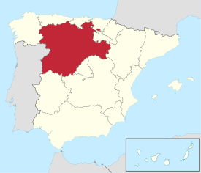
About ITACyL (Spain)
  Agricultural research and innovation public entity
  Two teams specialized in Geo-technologies for agriculture
      Research and Innovation: Earth Observation, agrometeorology and soil science, crop modelling, GNSS
      CAP support: LPIS upkeeping, OTSC and CbM
National Ministry of Agriculture
FEGA (Coordinating body)
Castilla y León Ministry of Agriculture
DG Common Agricultural Policy.
Castile and León is the 12th largest EAGF paying agency in Europe.
94,000 km2
DG Agricultural Technological Institute(ITACyL)

Slide 3

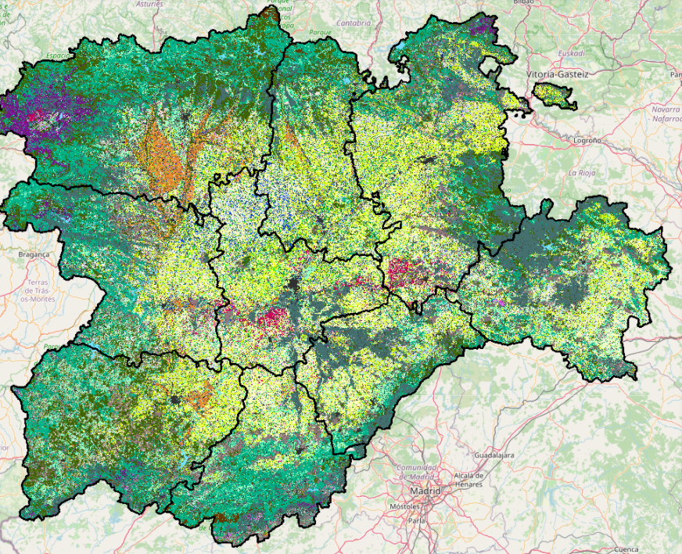
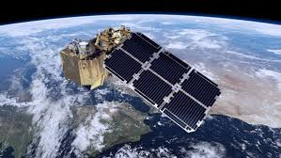


How did we get involved? Pre-CAP monitoring
2014 -2015
2016-2017
2018
USDA (CDL) methodology.
Use of Deimos-1 and Landsat-8
First Crop Map Classification (mcysncyl)
Sentinel-2 images availability
EC starts shifting towards CbM
PA requirements collection
Workflow to integrate RS data and Crop Map Classification within IACS.
Deployment of the infrastructure
2011
2016
2020…
Notes:
A brief introduction to the context, how/why you got involved ('the story behind')

Slide 4
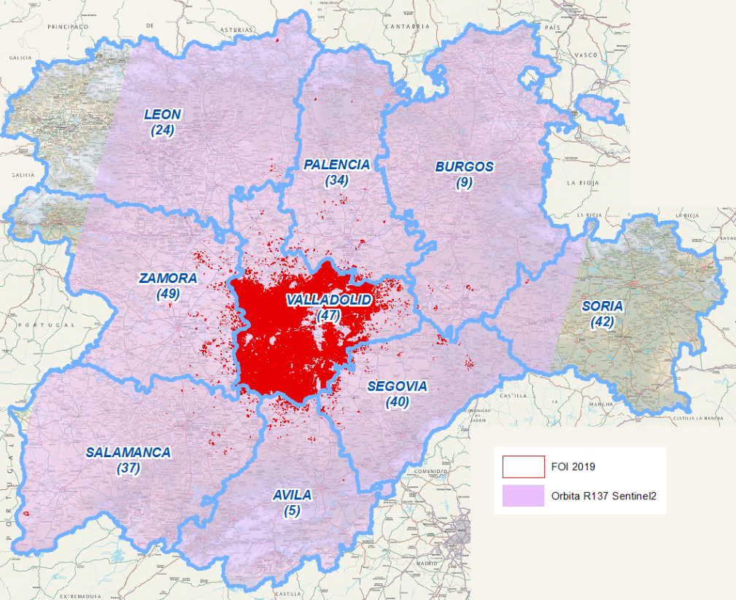
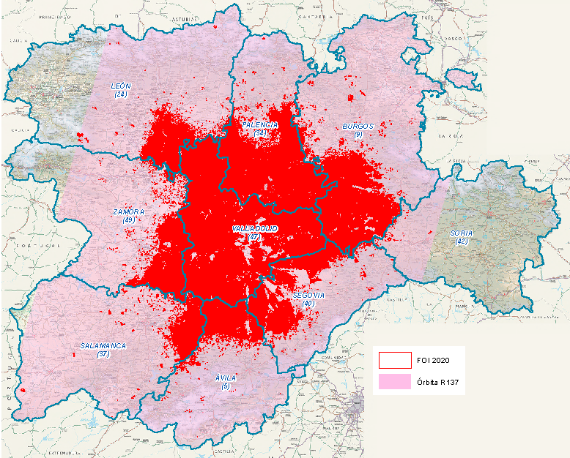
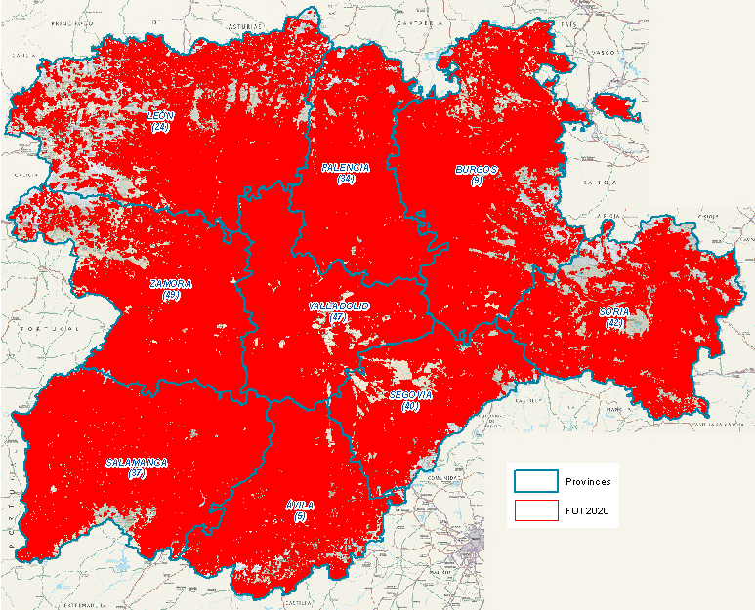
Operational monitoring
2019
Full 1st Pillar
6.4% Claim Area
2020
1st & 2nd Pillar
29.5% Claim Area
2021
All 1st & 2nd Pillar
100% Claim Area
(5,293,871 ha)

Slide 5
What do PAs need to set a monitoring system?
Webapp with open layers (IACS team)
Sentinel-hub API (Sen4cap)
Farmers application software
  Updated with current season satellite imaginary
  Preloaded markers from previous years and current season land cover
Image downloading and pre-processing scripts (signals)
Derived products for crop and ag. practices identification (markers)
Vector intersection to store markers in Monitoring DB next to IACS DB
Decision rules based in Monitoring and IACS databases.
Expert judgement tool that integrate application data (IACS) with signals, markers and rules.
Farmer Interaction APP (notifications, geotagged pictures, etc.)
essential
Bunch of Batch files and manual operations
essential
Python (rasterio, numpy, panda)
essential
PL/SQL
Webapp with open layers (IACS team)
essential
Responsive Webapp with lots of API
Notes:
type of data (for Pillar 1 and Pillar 2 if you can distinguish), its usefulness / value added, the role of the PA in data collection and storage, ...
Challenges encountered and recommendations/tips on how to overcome them: what has worked well,

Slide 6



How to set up the new system
Decide what to keep in the IACS (mandatory upgrade) and what to do externally (Remote Sensing segment)
Decide where to set up the new “external” services:
  Local installation in your premises
  Cloud services
  Take advantage of API provided by other companies
Take advantage of pre-existing developments (Sen4cap, jrc-cmb,..)
Be prepare to personalize markers, develop decision rules mixing EO signals, markers and IACS data

Slide 7
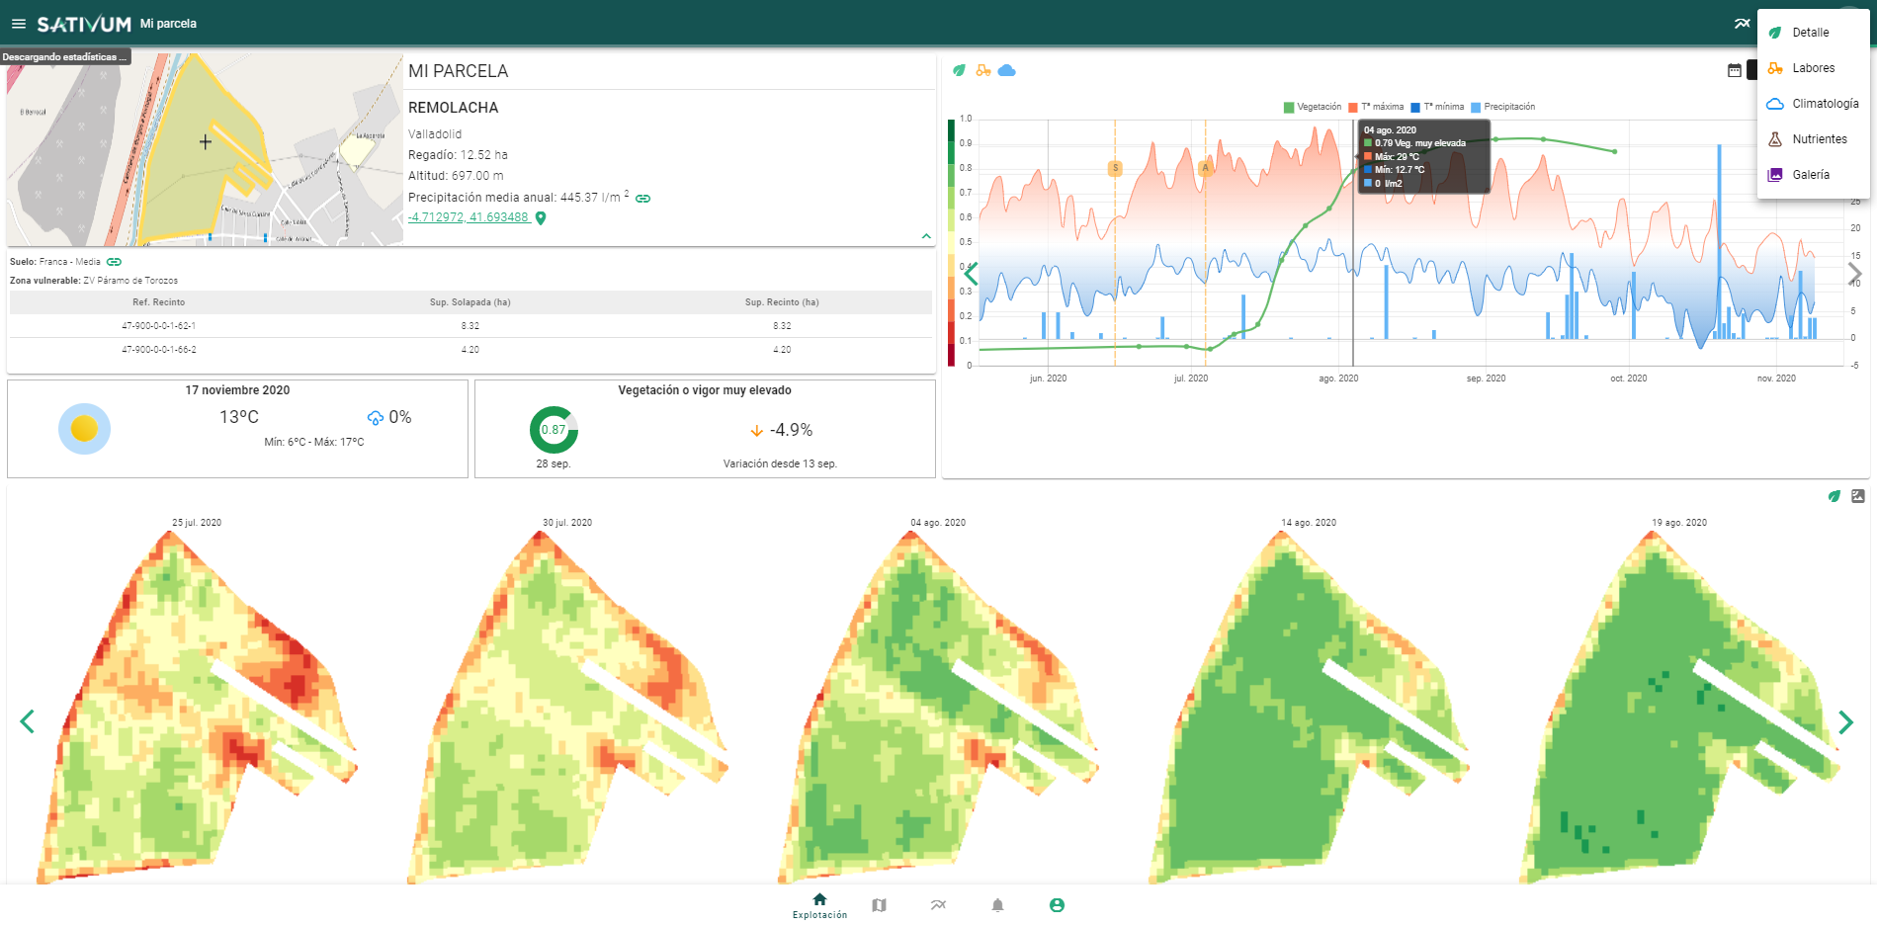

Not just controlling: Tools to support farmers

Slide 8
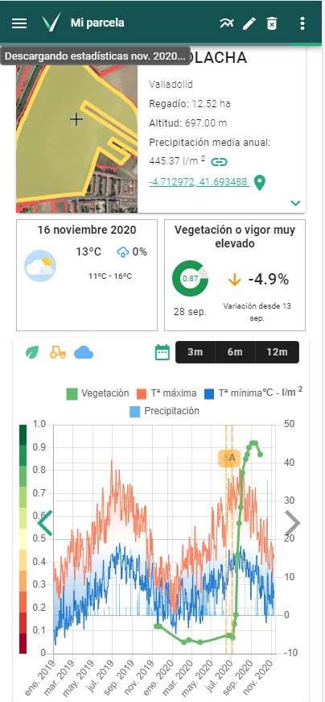
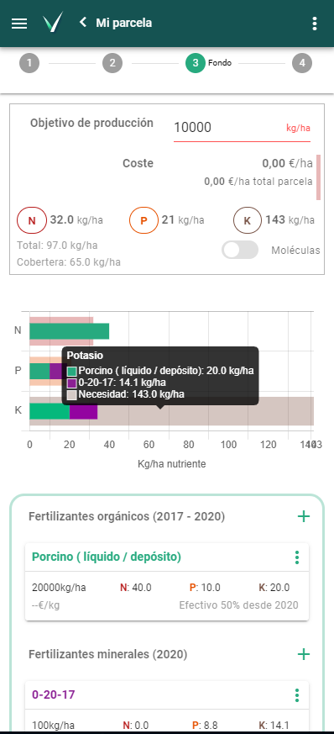
FAST integration
Linked to IACS
Lots of in-situ data
Based on open APIs offered to 3rd party APPs
Foster digitalization in agriculture
https://www.sativum.es/

Slide 9
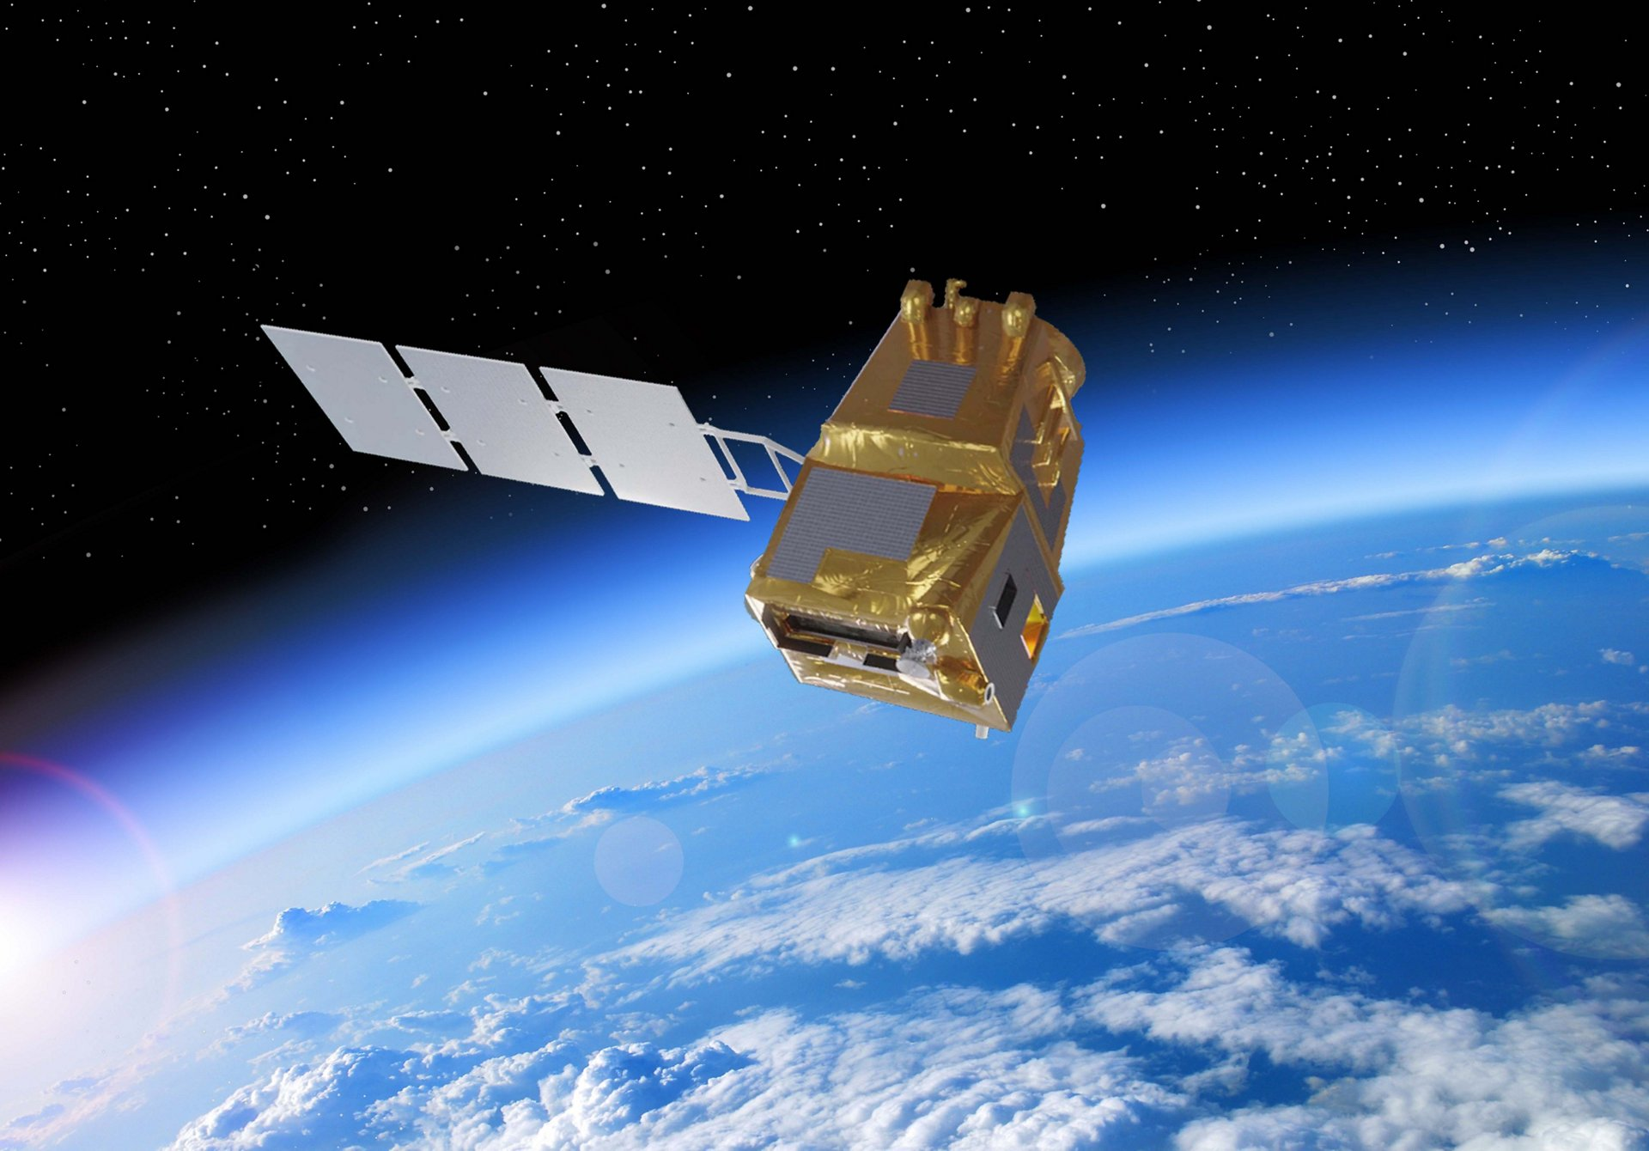
Copernicus in the future from a PA perspective
Operationalization of RS has been a key element.
Temporal vs spatial resolution improvements in Sentinel-2
Going further from S-1 & S-2, new sensors to improve Agricultural monitoring : i.e. Sentinel-8 LSTM (Land Surface Temperature Monitoring)

Slide 10


