Slide 1
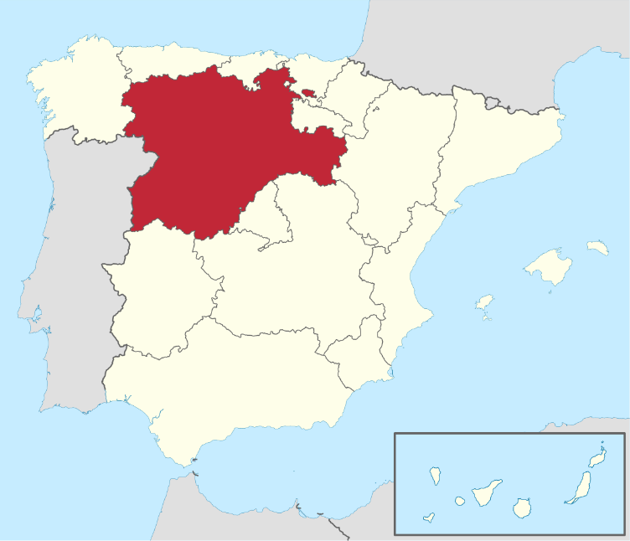

Our organisation in brief
  Research and IT public entity that belong to the Regional Ministry of Agriculture of Castile and León –Spain- (12th largest EAGF paying agency in Europe).
  300 employees in Research, Rural Infrastructure development, IT, field extension and food certification and promotion
  Two departments specialized in Geo-technologies for agriculture.
    CAP support (LPIS upkeeping, On the spot checks, and Checks by Monitoring)
    Research and innovation (Earth Observation, agrometeorology and soil science, crop modelling, GNSS)

Slide 2
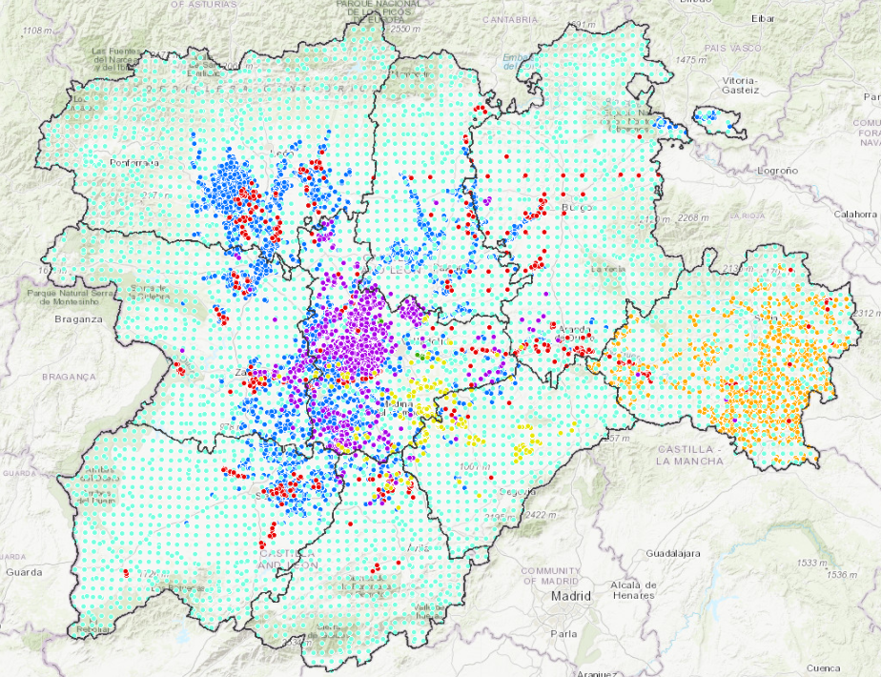
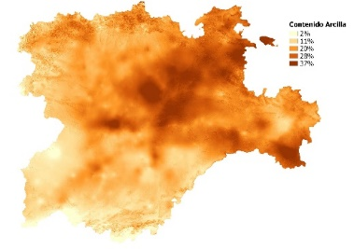
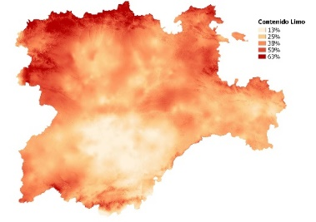
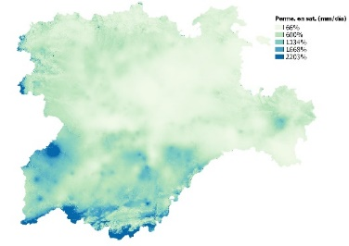
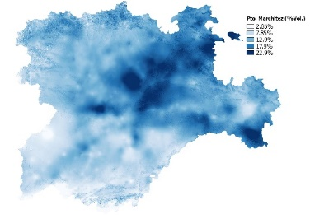
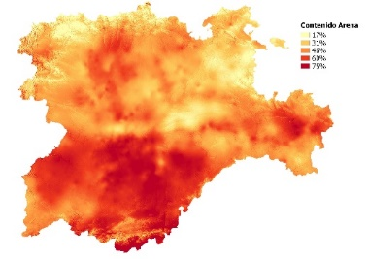
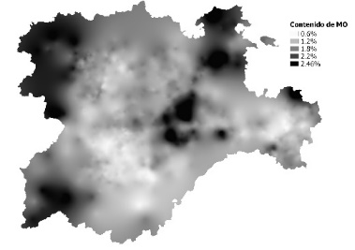
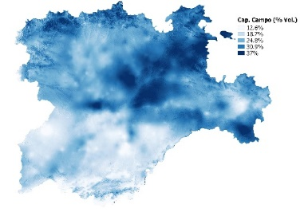
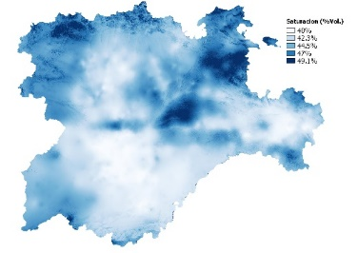
19,000 soil samples analitics and derived maps

Slide 3
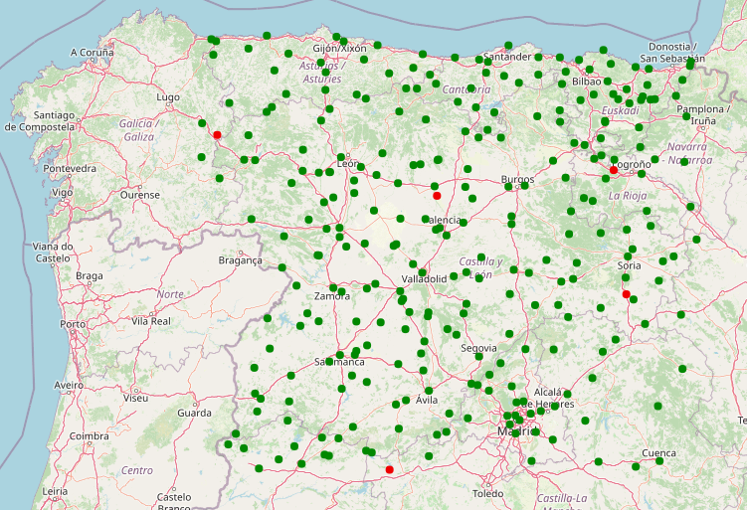
200 automatic meteostations (ITACyL+ National Met agency) some with soil moisture sensor

Slide 4
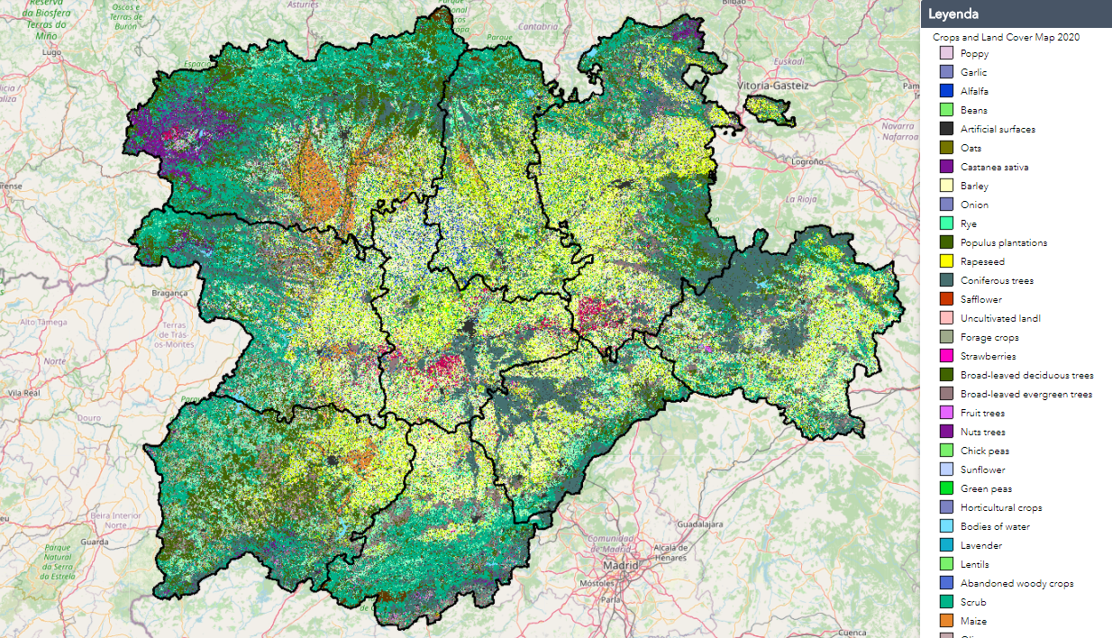
Anual crop mapping since 2011 based on remote sensing and machine learning

Slide 5
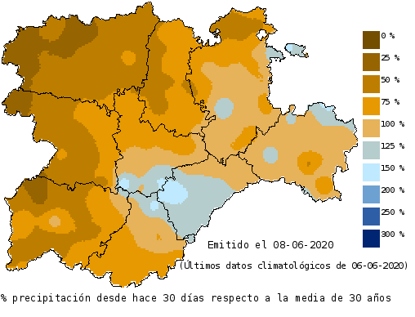
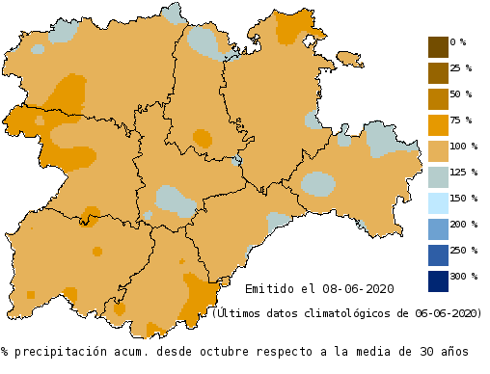
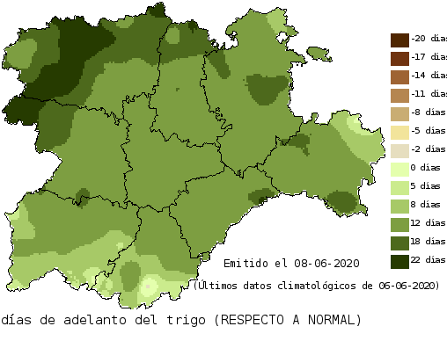
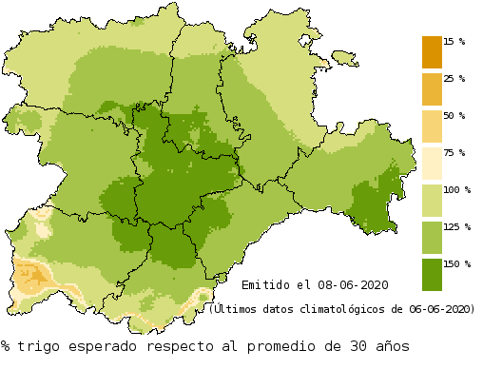
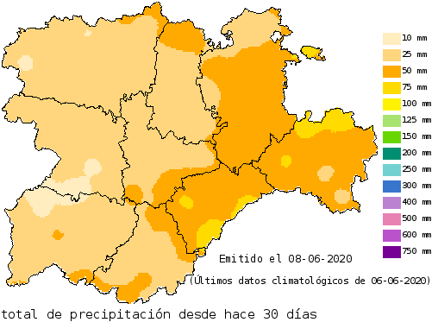
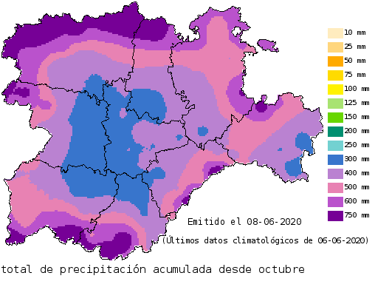
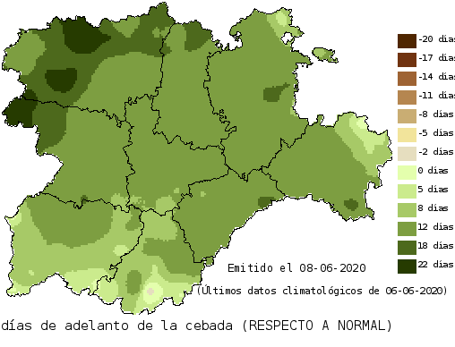
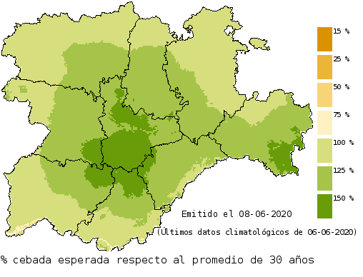
Yield forecasting system

Slide 6
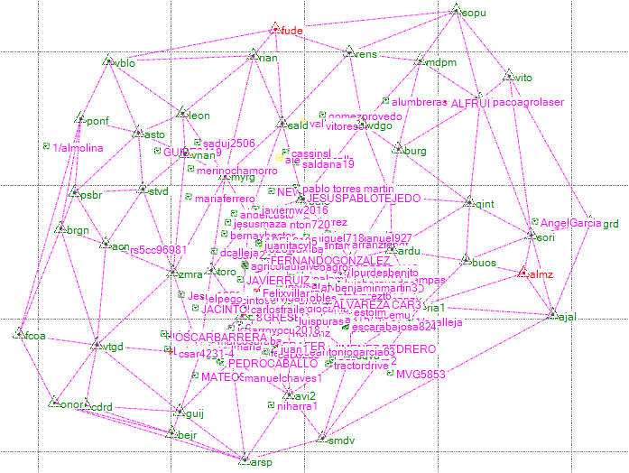
Live machine GNSS tracks from RTK network service
Date,Speed,wkt
25/09/2020 | 0.1446 | point( 42.50659106 -4.5026340933333335)
25/09/2020 | 0.0124 | point( 42.50659096 -4.502634211666667)
25/09/2020 | 0.0033 | point( 42.50659099666667 -4.50263423)
25/09/2020 | 0.0012 | point( 42.50659100833333 -4.50263424)
25/09/2020 | 0.0011 | point( 42.50659101 -4.502634226666666)
25/09/2020 | 0.0015 | point( 42.50659099166667 -4.502634228333333)
25/09/2020 | 0.0034 | point( 42.50659097 -4.502634191666667)
25/09/2020 | 0.0013 | point( 42.506590978333335 -4.5026341783333335)
25/09/2020 | 0.0004 | point( 42.506590978333335 -4.502634183333333)

Slide 7
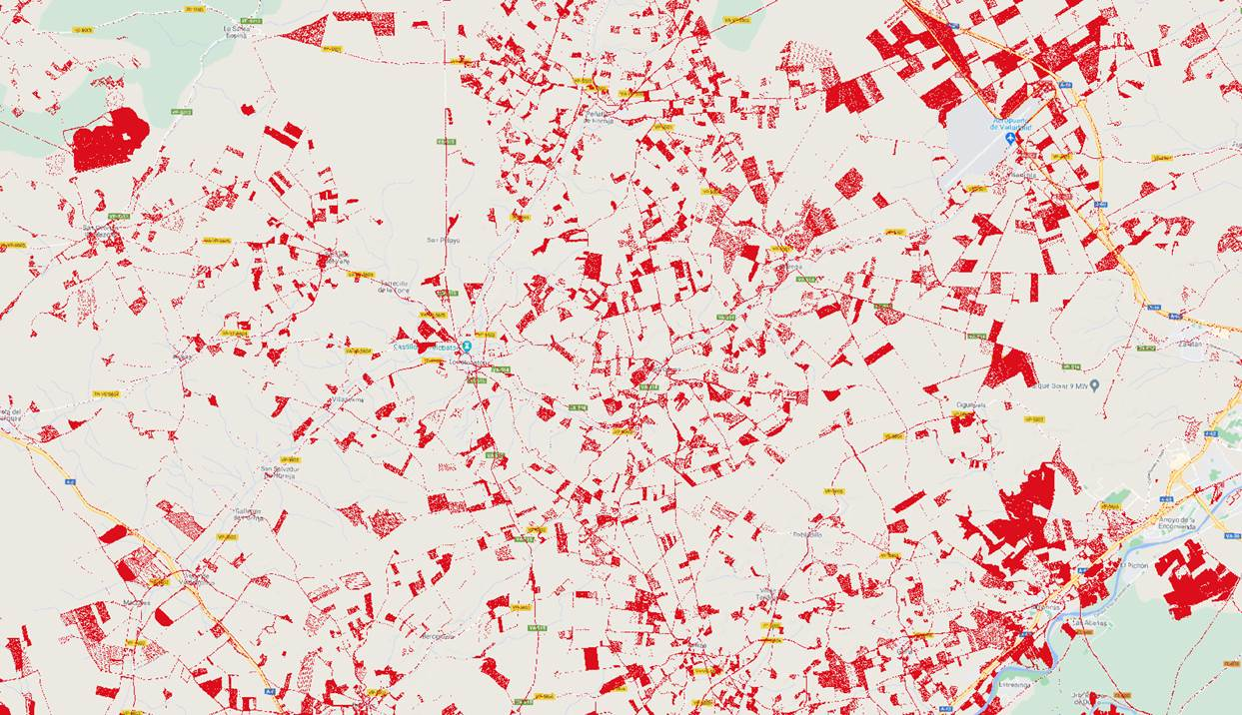
Already receiving machine tracks in RTK service

Slide 8
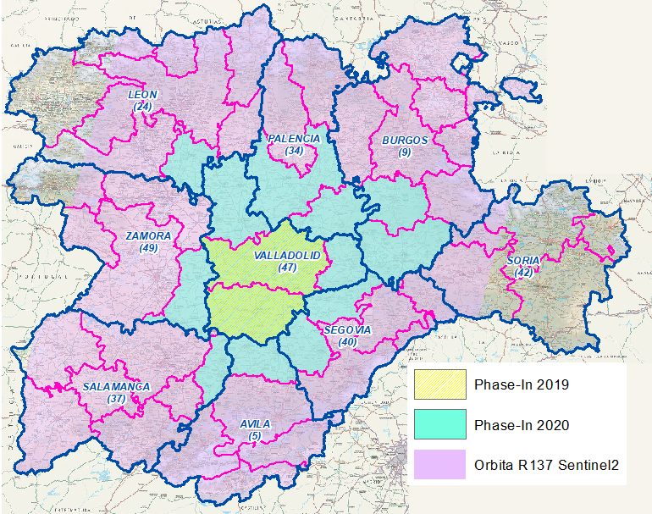
CAP fully implemented Checks by Monitoring 100% of the area full schemes
Schemes
Base payment
    BPS / SFS
    Crop Diversification
    EFA
    Grasslands
    Protein crops
    Oilseed
    Legumes HQ
    Sugar beet
    Nuts and carob beans
    Extensive rainfed agroecosystems
    Integrated agricultural production
    Industrial crops
    Grazed forage areas
    Organic farming
    Areas with naturals constraints
Greening
1st Pillar
VCS
2nd Pillar

Slide 9
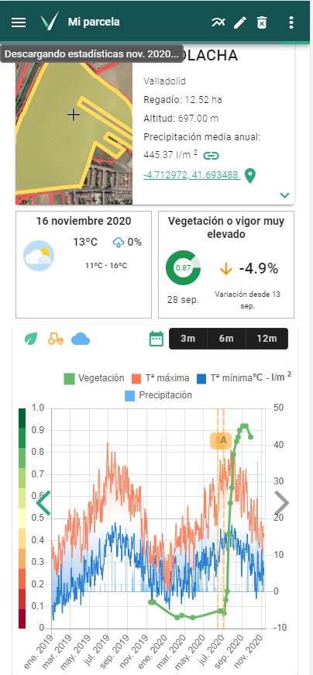
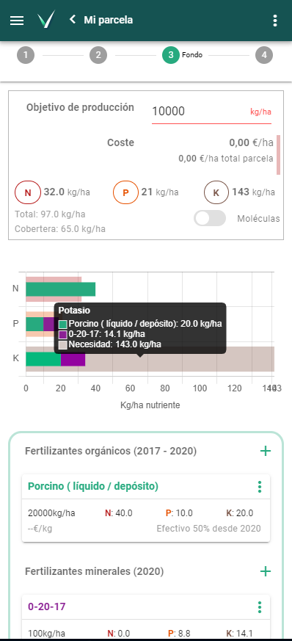
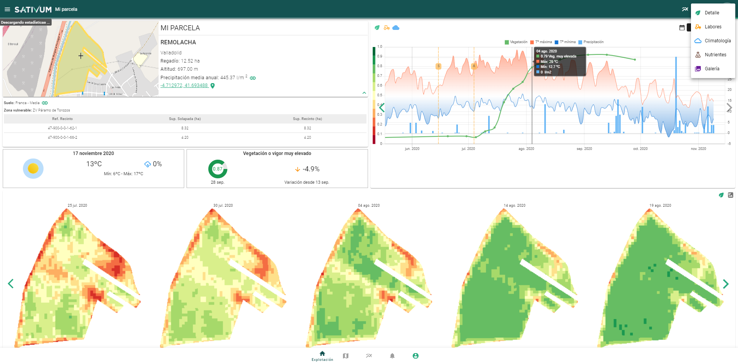
New Agronomic FMIS tool for farmers linked to IACS

Slide 10
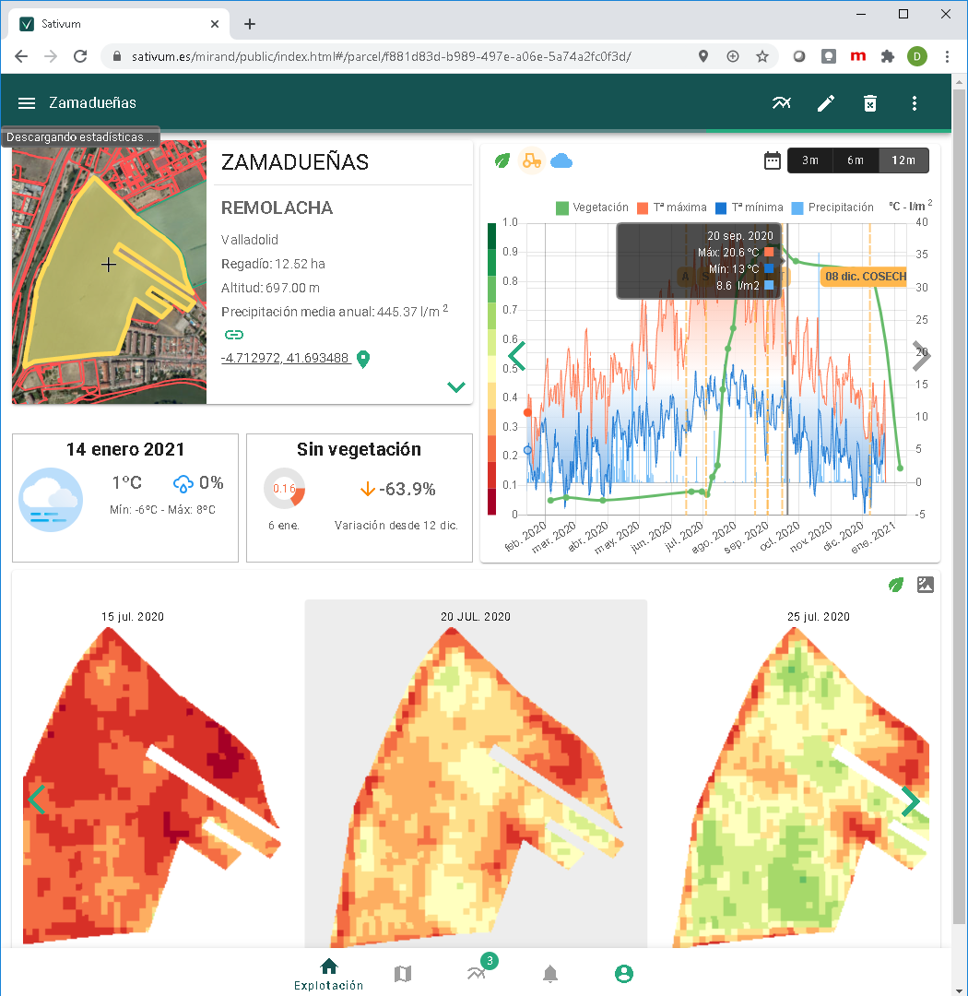
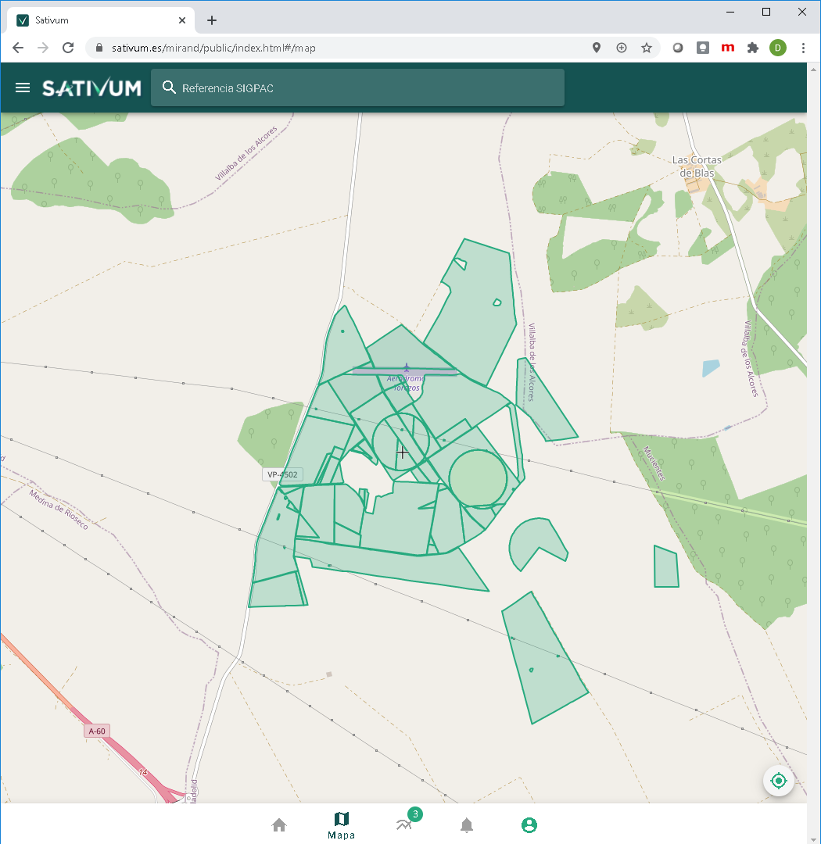
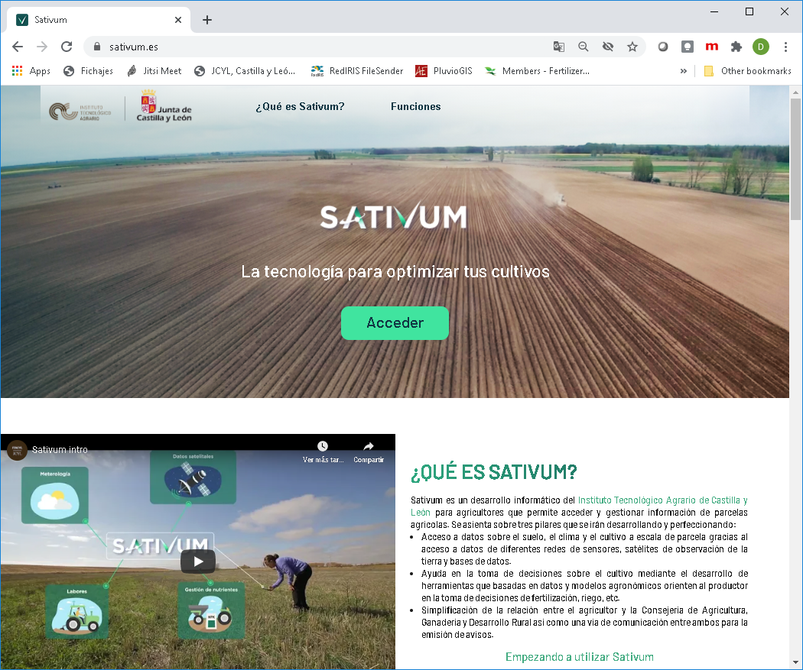
Public PA FMIS tool

Slide 11
Contributions
We can contribute to the SARAGRI ....
IACS connection linked to Earth observation infrastructure
Complementary environmental data (Soil, meteo, crop ID)
Good knowledge of user requirements in the agricultural private sector and government monitoring needs

