Slide 1
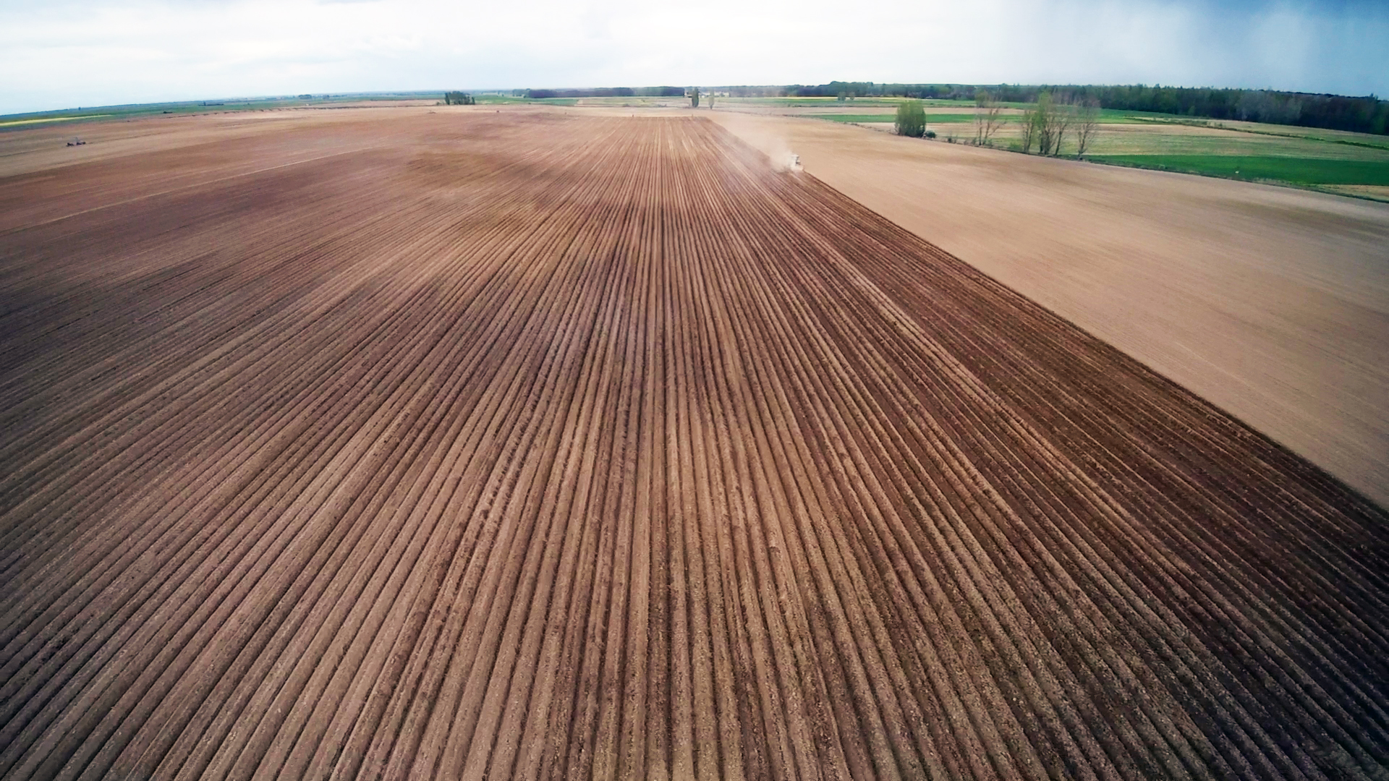

SATIVUM
Fertilization advice in Castilla y Leon (Spain)
David A. Nafría nafgarda@itacyl.es

Slide 2
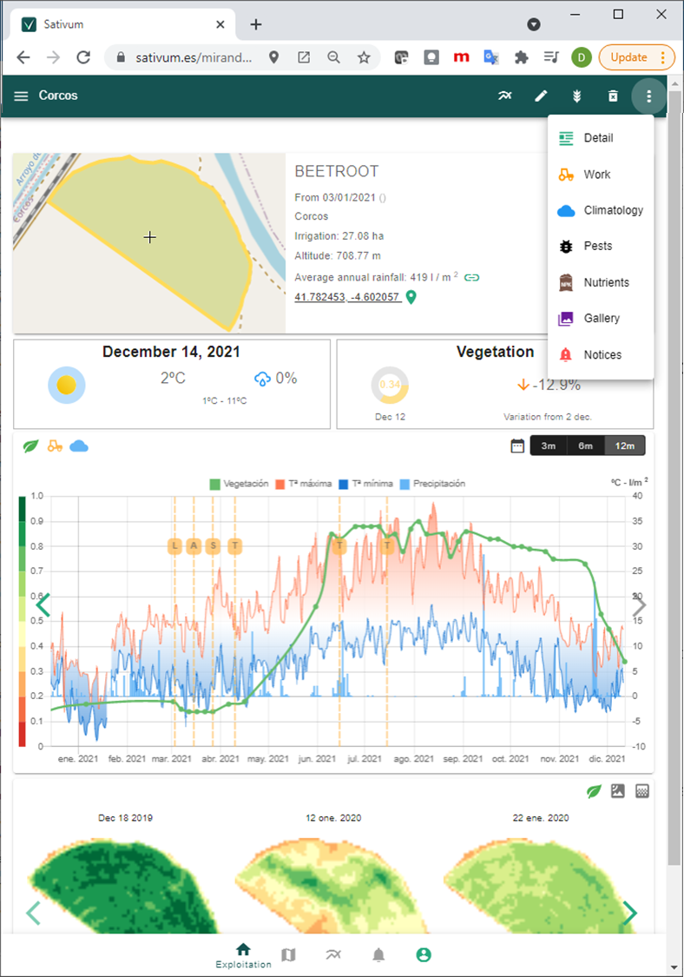

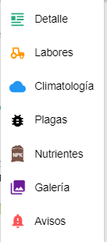
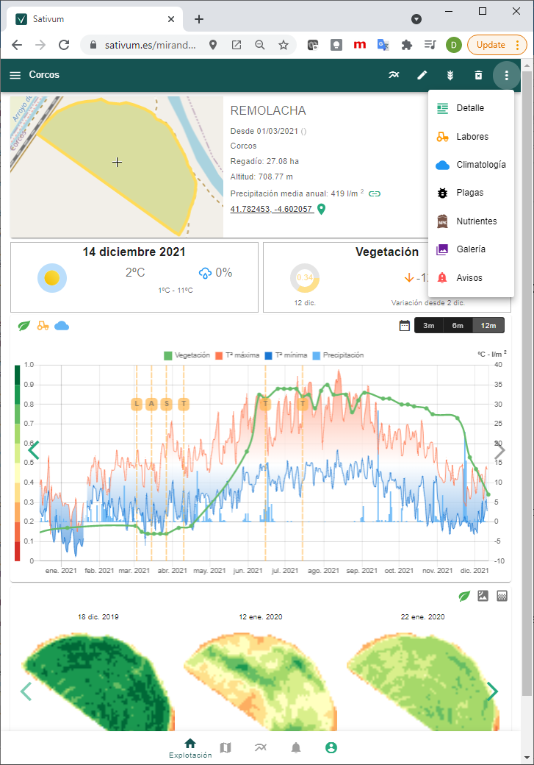
Sativum is a free public APP for agronomic advise based on agricultural parcels from IACS with:
  Satellite (and aerial) data
  Soil data(0,3 samples/km2 density)
  Climate/meteo data (0,002 stations /km2)
Decision support systems integrated:
  Crop nutrition (FAST)
  Pest management
  Irrigation (beta)
  More to come
https://www.sativum.es/

Slide 3




FERTILICALC+FAST+SATIVUM
FERTILICALC
(Python GPL)
SATIVUM
FAST (Spain)
SOIL DATA
LPIS+GSAA
IACS ACCESS AUTENTICATED
OPEN NUTRIENT NEED API
NPK NUTRIENT NEED ALGORITHM
(API)
COPY
FERTILIZATION FRONTEND
CROP PARAMETRIZATION UPDATE
End of phase I
FRONTEND UPDATE

Slide 4
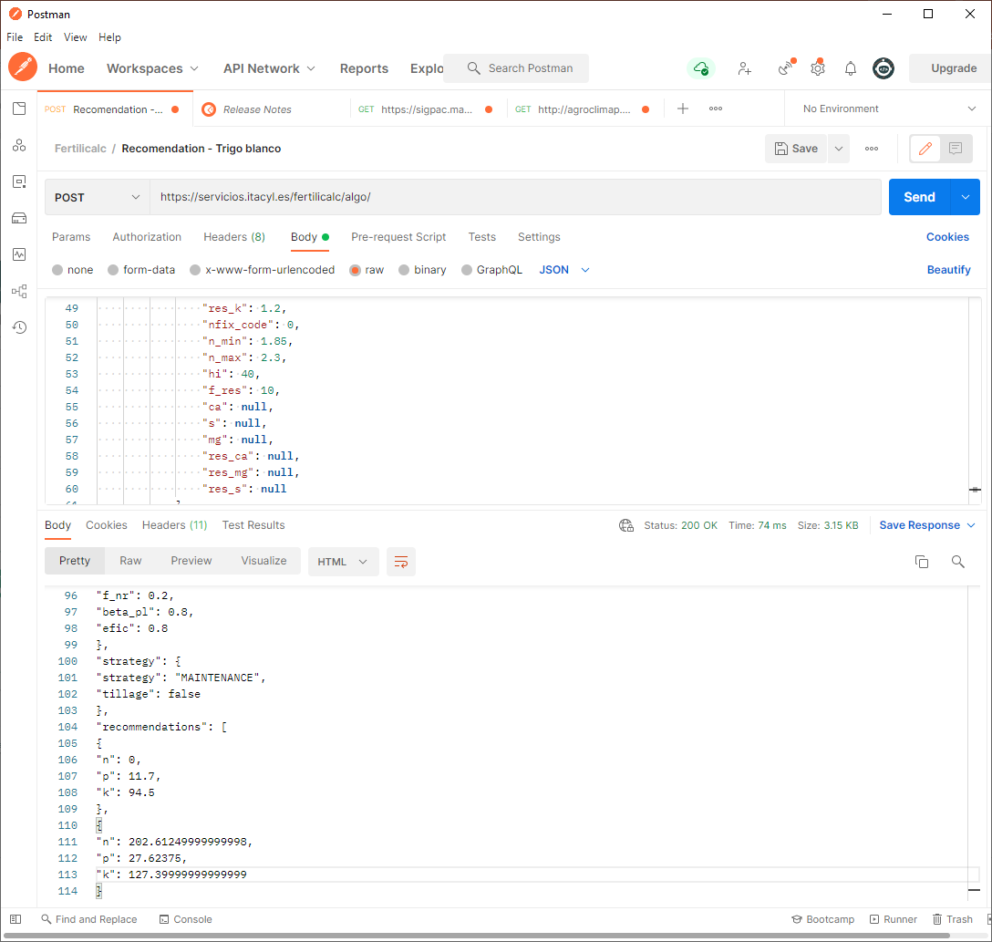
API URL
PARAMETERS TO SEND
RECEIVED NPK NEEDS

Slide 5
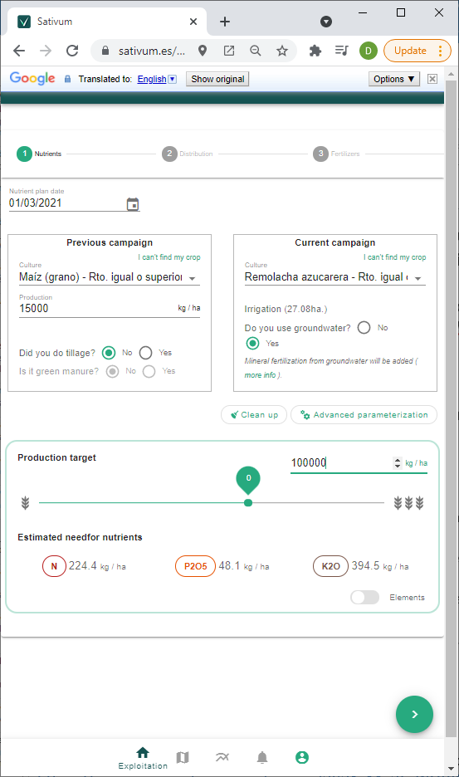
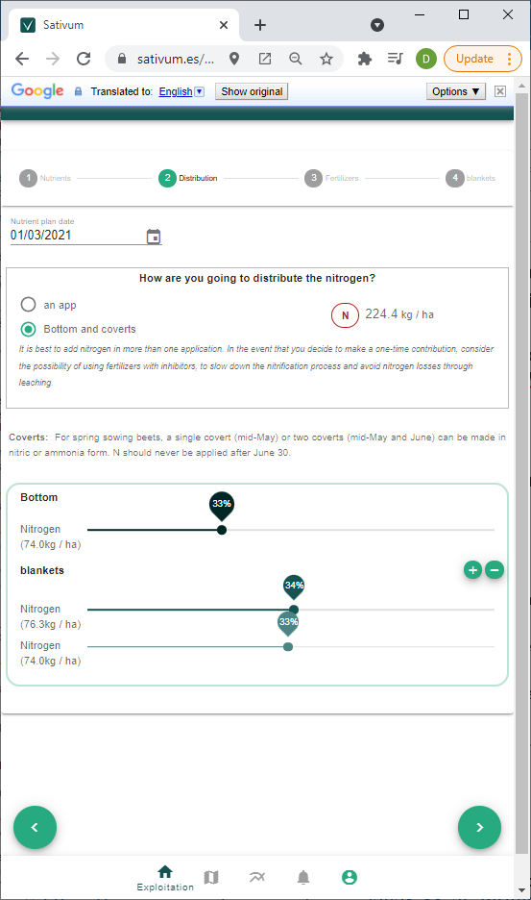
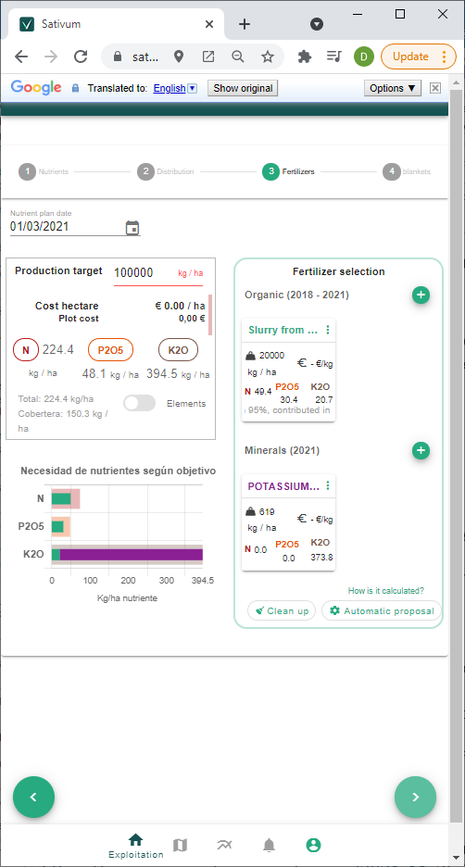

Slide 6
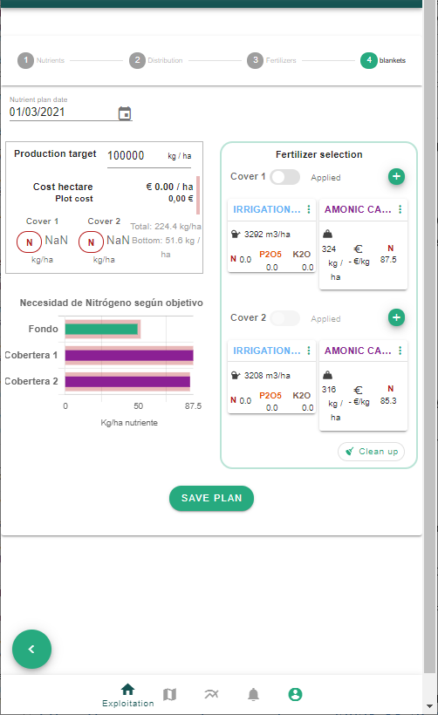
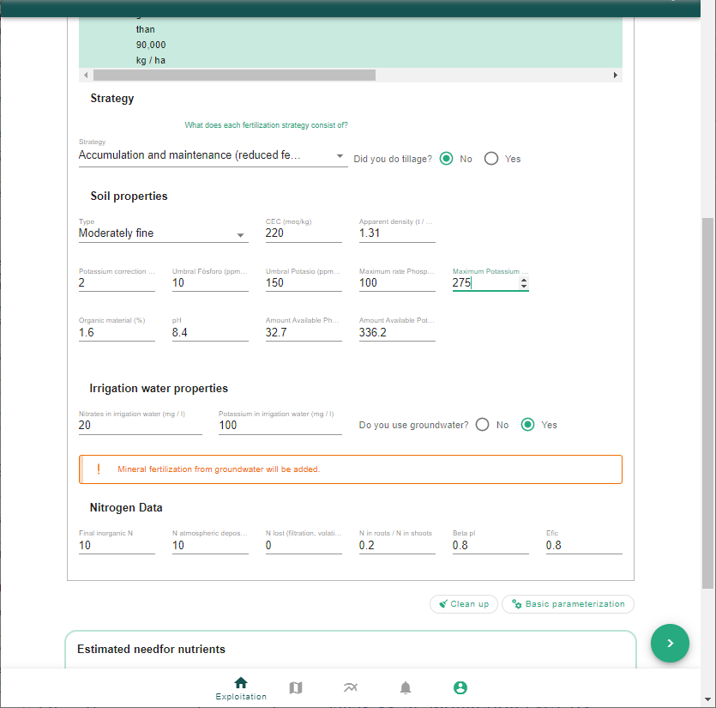
ADVANCED PARAMETRIZATION

Slide 7
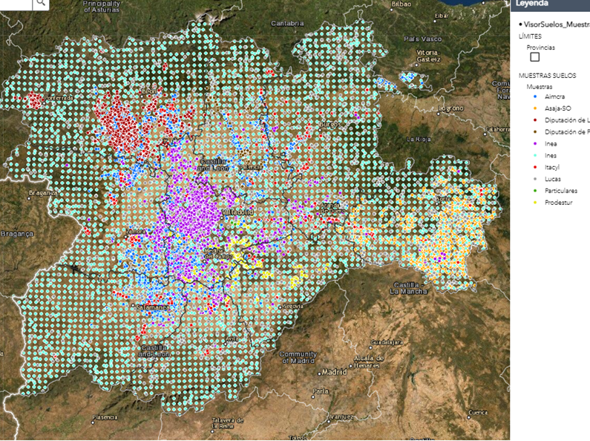
Soil database
Ongoing data colection sinze 2011
Most data comes from external colaborators, national and EU databases (LUCAS)
30.000 georreferenced sampled points
http://suelos.itacyl.es

Slide 8
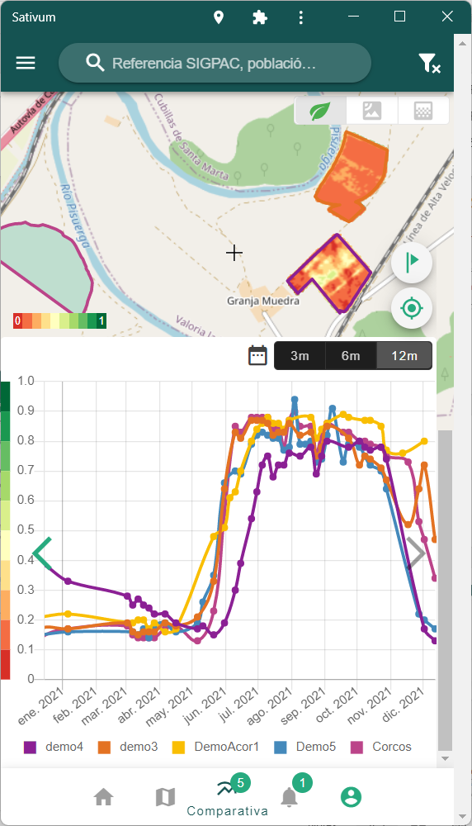
Conclusions
SATIVUM is a fork of FAST phase 1 running operationally
Many improvements done in the front end since the end of EC FAST Phase I.
Very interested in improving the tool: There are good foundations for prescription but it would be nice to start modelling the N dynamic along season.

