Slide 1
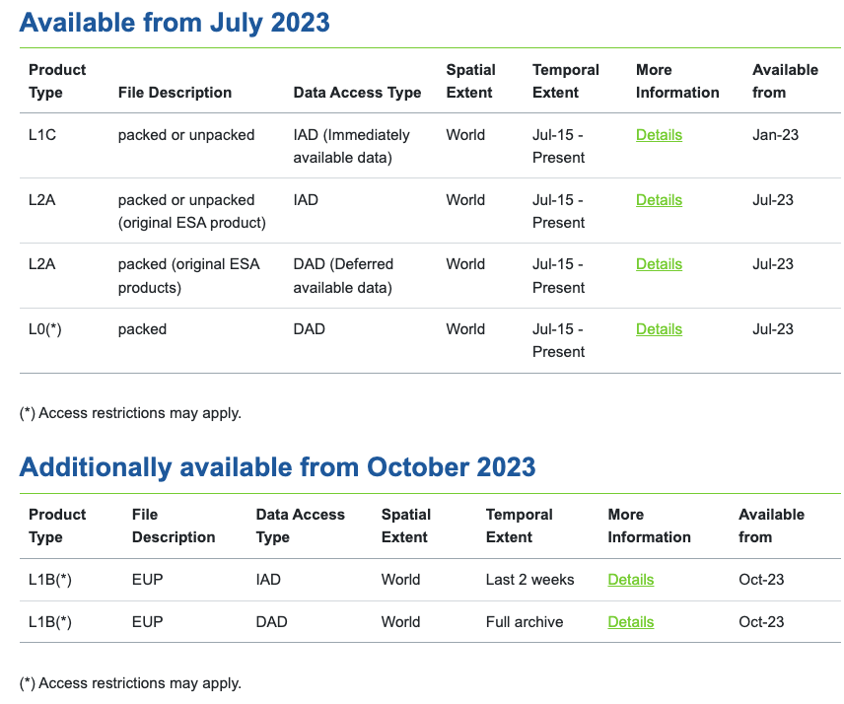
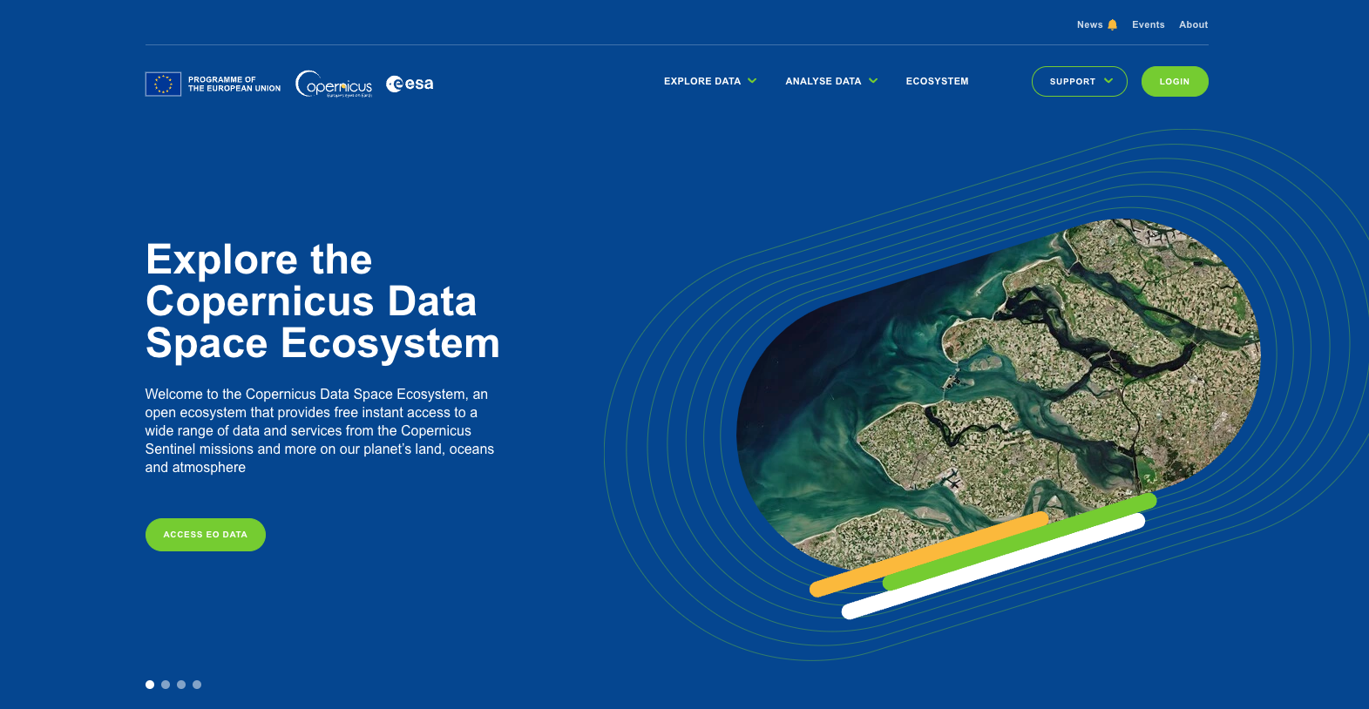
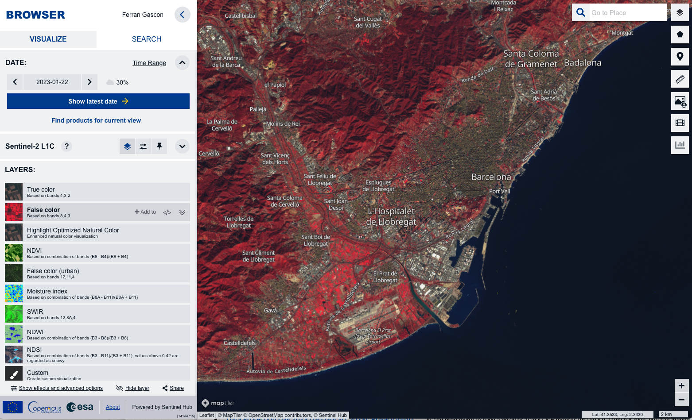
Copernicus Data Space Environment
https://dataspace.copernicus.eu/
Access to the new Collection-1 products will be gradually made available during 2023.

Slide 2
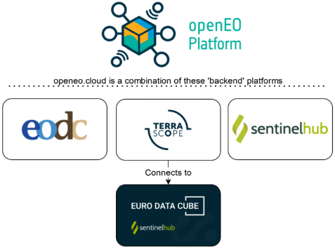
Sentinel-2 + Landsat Level-2H/2F Pilot Production
Level-2H and Level-2F pilot products will be available through openEO Platform [https://openeo.cloud] as from Q3 2023.
Sen2like processor integration in openEO Platform (ongoing):
(1) on-demand product-based processing via web-based GUI, retrieve L2H/L2F products in original SAFE format.
(2) dedicated sen2like openEO process, allowing to dynamically process user-defined temporal-spatial extents & use harmonised/fused datacube in workflows.
The pilot service above will be free-of-charge as sponsored by ESA’s NOR (Network Of Resources): https://nor-discover.cloudeo.group

Slide 3
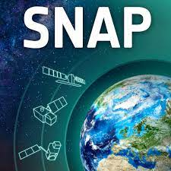
SNAP (Sentinel Applications Platform)
Core Modules
Plug-ins
S2 L1C/L2A reader.
S2 level 2H/F reader.
S2 Resampling Processor.
Multi-size mosaic (mosaic at native resolution).
Reflectance to radiance module.
Biophysical Variables Retrieval (S2 L2B).
Radiometric Indices Processor (vegetation, soil and water).
Forest Cover Change Processor.
C2RCC Processor (Case 2 Regional Coastal Colour).
S2 MCI Processor (Maximum Chlorophyll Index).
The Rayleigh Correction Processor.
Sen2Cor – Atmospheric Correction and Cloud screening.
Sen2Res - To enhance the spatial resolution of Sentinel-2 products (SuperResolution).
Sen2Three – Spatio-temporal synthesis L3.
Sen2Coral – Module for Coral Reef monitoring.
Sen-ET – Module for evapotranspiration (ET) estimation using S2 data.
iCor – Atmospheric Correction for land and aquatic areas.
IdePix – Scene Classification including Cloud screening.
S2 Toolbox OTB adapters – Module including Orfeo Toolbox.

Slide 4
ESA World Cover 2021
Fast generation and validation of a world land cover based on S2 and S1.
10m resolution
11 land cover classes
Delivered 10 months from last data take
77% overall accuracy, validated independently
Views: 17470
Downloads: 7057
Product will be made operational by the CLMS (Copernicus Land Monitoring Service) in 2023.
https://worldcover2021.esa.int

